Slide 1
The Nucleus’ Physical Role in Collective Cell Migration
Presented By: Brady Hine
Notes:
I’m currently a MECH 498 student and the problem I’m trying to address is how mechanical properties of the cell nucleus affect the process of collective cell migration.

Slide 2
Introduction
Significance
Problem
Cell repopulation
Wound healing
Developmental tissues
Collective migration
Nucleus limiting factor
Scratch wound assay
Notes:
Collective cell migration is a necessary function for many biological processes to work effectively including, but not limited to, repopulation of cells after tissue engineering, wound healing processes, or formation of developmental tissues. The nucleus’ importance in this process is that it serves as a limiting factor for migration due to it often being the largest and stiffest organelle in the cell. To investigate the effects of these impacts on collective cell migration a scratch wound assay model is being used where a layer of cells is cultured, a scratch is applied, and time lapse imaging of the healing process is then used to quantify migration parameters.

Slide 3
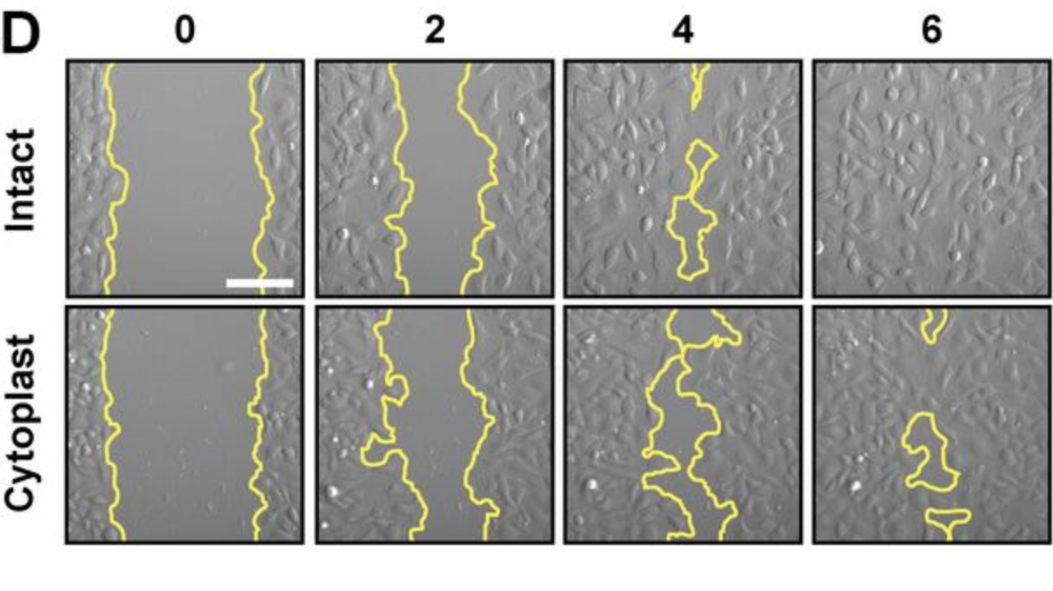
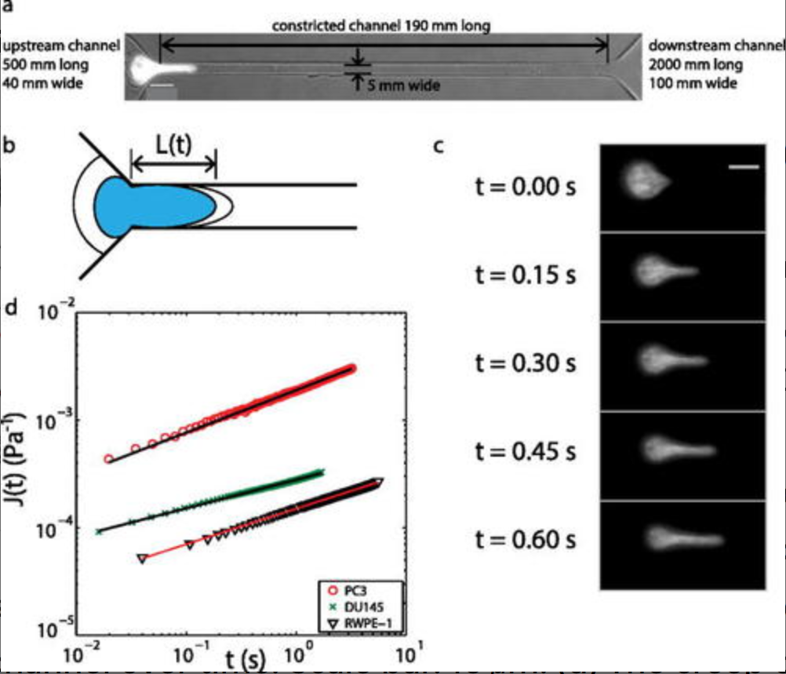
Previous Approaches
Enucleated mammal cells
Only planar migration
Decreased migration efficiency
Metastatic prostate cancer
Cancer vs. normal cell nucleus
Varied aggressiveness
D. M. Graham et al., “Enucleated cells reveal differential roles of the nucleus in cell migration, polarity, and mechanotransduction,” J. Cell Biol., vol. 217, no. 3, pp. 895–914, Mar. 2018, doi: 10.1083/JCB.201706097.
Z. S. Khan, J. M. Santos, and F. Hussain, “Aggressive prostate cancer cell nuclei have reduced stiffness,” Biomicrofluidics, vol. 12, no. 1, p. 014102, Jan. 2018, doi: 10.1063/1.5019728.
Notes:
Previous approaches to this problem involved using enucleated mammal cells or cytoplasts and compared their migratory abilities to those of intact cells. It was found that the cytoplasts were no longer able to migrate in a 3D space and that planar migration had decreased in efficiency as seen on this image here where the wound from a scratch wound assay is outlined in yellow. Another approach looked at varying levels of metastatic prostate cancers using a nuclear creep experiment with a tight constriction in a microfluidic channel. Their results showed that more highly metastatic cancer cells were able to travel faster through confined environments than those less metastatic. The imaging from these tests then allowed the researchers to measure the nuclear stiffnesses of the cells and found a trend that the more aggressive the cancer cell was, the softer the nucleus was.

Slide 4
Specific Aims
Aim #1
Establish a scratch wound assay of cell migration using NIH-3T3 cells
Migration quantification and validation
Y27 (myosin contraction inhibition) and/or cyto-D (actin inhibition)
Aim #2
Observe how changes to nuclear mechanics affect migration parameters
Modify stiffness and chromatin remodeling
Trichostatin A (softening by HDAC inhibition) and GSK126 (stopping chromatin remodeling)
Notes:
That leads me to the specific aims for this project. The first of which being to establish the scratch wound assay that will be used to conduct these migration experiments. This aim will also include determining methods for quantifying migration as well as validating the setup by using some migration inhibitors listed here. The second aim for the project will involve observing how changes to nuclear mechanical factors impacts the quantified migration parameters. Modifying the nucleus’ mechanical properties will be done by applying these drugs that will affect chromatin remodeling and nuclear stiffness.

Slide 5
Specific Aims
Aim #3
Perform live imaging of the cytoskeleton and nucleus at high resolution to quantify a strain map in the cell monolayer.
NucBlue (nucleus) and Lifeact (actin)
Future work
Investigate interactions between nuclear mechanics with substrate mechanics and cell crowding
Notes:
The last specific aim for this project will involve using live staining and imaging of the nucleus and actin cytoskeleton during the scratch wound assay. This data will then be used to develop a strain map at the cell monolayer level providing detailed mechanical insight into the migration process. If these aims are successfully met, it’d help lay groundwork for looking into interactions of nuclear mechanics with cell crowding effects and substrate mechanics.

Slide 6
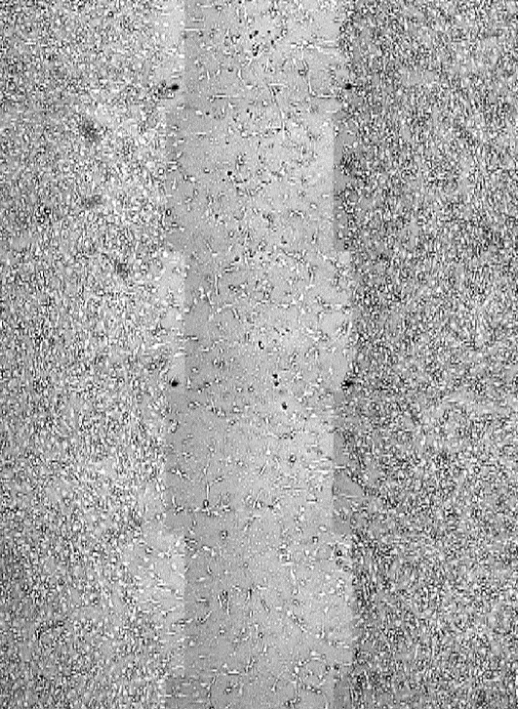
Work to Date
Establishing Assay
Scratch methodology
Imaging timeframe (~12 hrs)
Cell maintenance
Cell Staining
Fixed nucleus (DAPI) and actin (phalloidin)
Live nucleus (NucBlue)
Cell Tracking
Notes:
Most of the preliminary work done to this point has been spent establishing the scratch wound assay. t was important to establish a repeatable method for making scratches on the monolayer with as clean edges as possible which was done using a pipette tip and straight edge as a guide. Next was determining the optimal timeframe for imaging the cells after applying the scratch which seems to be somewhere around 12 hours. This took a while to determine due to the cells needing medium applied at intervals so they don’t dry out during imaging limiting the times data could be collected. This video here was an early capture taken after the wound had fully sealed which was difficult to gather quantifiable data from. Thus, work has also been done establishing cell staining methods for actin and the nucleus in both live and fixed cells using the stains listed to track the nucleus and actin during migration. Different live and fixed stains are required due to live stains needing to be small enough to fit through pores in live cells whereas fixed cells can be permeabilized.

Slide 7
Work to date
Notes:
The image here was one of the first attempts at the scratch wound assay which left a crude scratch and debris not optimal for this experiment. Applying the scratch methodology mentioned earlier, more ideal scratches were created which can be seen on this image with cleaner edges. This image was taken after the cells had already closed the wound and used fixed staining for the nucleus in blue and actin in green. Zooming in we can see actin tails from some of these cells showing where they had recently moved from as well as leading edge protrusions showing they were currently moving in a certain direction.

Slide 8
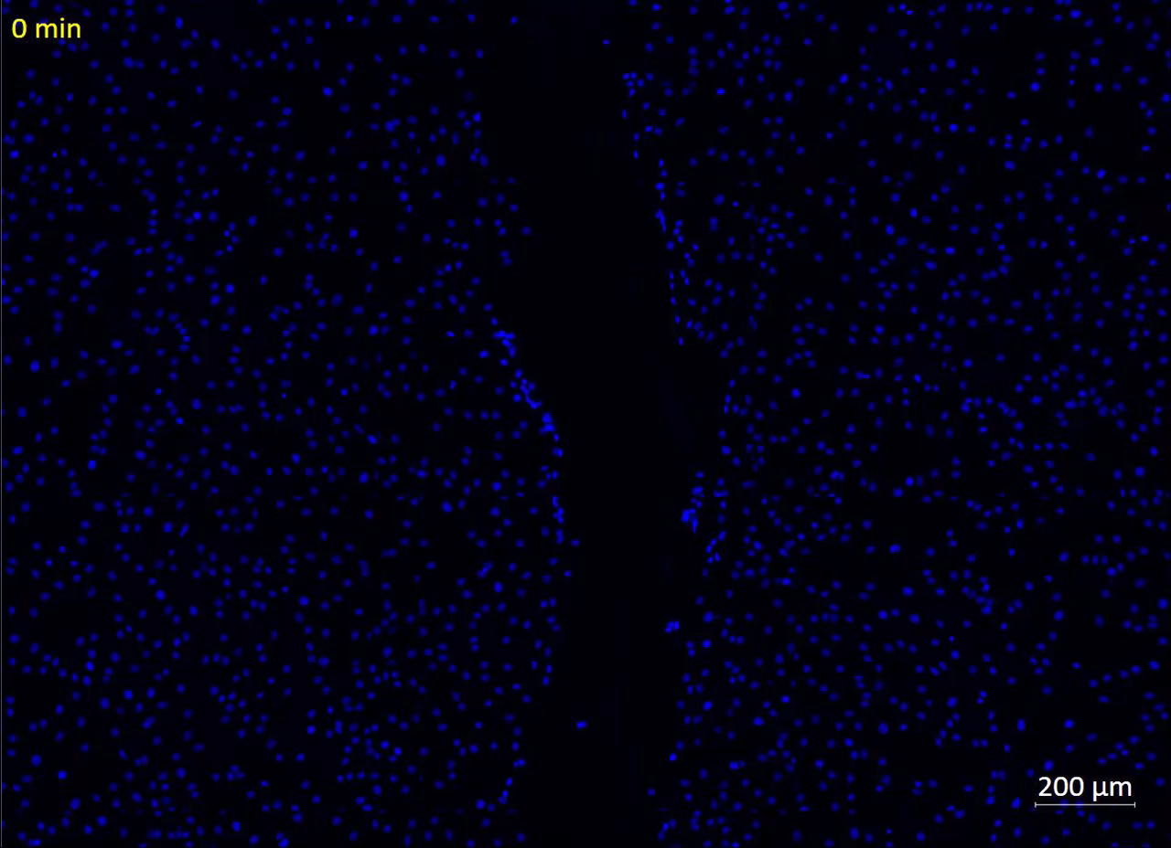
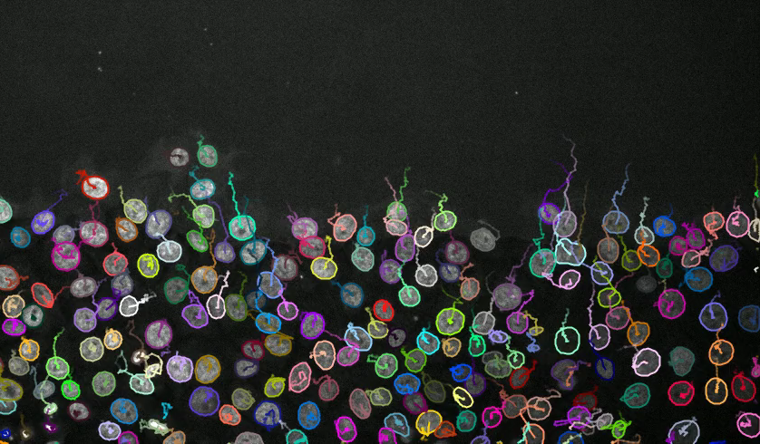
Current Work
Ershov, D., Phan, M.-S., Pylvänäinen, J. W., Rigaud, S. U., Le Blanc, L., Charles-Orszag, A., … Tinevez, J.-Y. (2021, September 3). Bringing TrackMate into the era of machine-learning and deep-learning. Cold Spring Harbor Laboratory. doi:10.1101/2021.09.03.458852
Notes:
What I’m most currently working on is using live nuclear staining to apply live cell tracking to quantify migration speeds of the cells. The video on the left here was one of our initial tests before we worked out some issues. Thus, there isn’t much migration observed in the data set but it serves to visualize how we plan to apply the automated cell tracking. On the right is a video of cells being individually tracked in a large cluster using an open-source plugin for ImageJ. As you can see, a path is traced for each distinct cell over time measuring distances travelled for each cell. From here movement speed can be calculated as well as persistence which is a measure of how straight these cell paths are. At the end of last week, better data was collected which I’m currently working to analyze.

